Slide 1
Intelligent Spam-Ham Classification System
BY WPS
Presented by :
Sanjay Kumar
Akshay Kumar
Shristi shikha
Jayshri

Slide 2
Contents
Introduction to Intelligent Spam-Ham Classification
System Analysis and Research Gap
01
02
catalog
Proposed System Architecture and Methodology
System Specifications and Components
03
04
UML Analysis and System Flow
Conclusion and Future Enhancements
05
06

Slide 3



The Digital Communication Challenge
Exponential Growth of Digital Communication
The contemporary digital era has witnessed an overwhelming increase in electronic messaging, including emails and SMS, making manual filtering of communications practically impossible due to the sheer volume of data.
The Pervasive Problem of Spam
This growth has brought forth the significant challenge of unsolicited, fraudulent, and malicious communications, commonly referred to as "Spam," which poses security risks and productivity loss.
Limitations of Manual Filtering
Manual inspection and moderation of communication channels are highly inefficient and prone to errors, leading to delayed threat detection and significant loss of workforce productivity in the face of massive daily digital data influx.

Slide 4
Purpose and Objectives of the System
System Purpose: Spam-Ham Classification
The primary purpose of the Intelligent Spam-Ham Classification System is to accurately categorize digital messages as either "Spam" or "Ham," safeguarding users from unsolicited and potentially malicious content.
Objective 1: Engineer an Automated MLOps Pipeline
A key objective is to build a modular architecture that spans data ingestion from MongoDB Atlas, validation, transformation, and continuous integration/continuous deployment (CI/CD) via GitHub Actions.

Slide 5
Identifying the MLOps Automation Gap
Absence of End-to-End MLOps Automation
While standalone machine learning models exist for text classification, there is a significant lack of end-to-end automated pipelines that manage the entire machine learning lifecycle, from data ingestion to continuous deployment.
Limitations in Existing Systems
Current systems often fail to incorporate dynamic data validation, continuous model evaluation, and automatic data drift detection, which are crucial for maintaining model performance over time.
Addressing the Gap with Modular Architecture
This project bridges the identified gap by introducing a modular architecture featuring continuous integration and continuous deployment (CI/CD) workflows, ensuring high reliability without manual interventions.

Slide 6
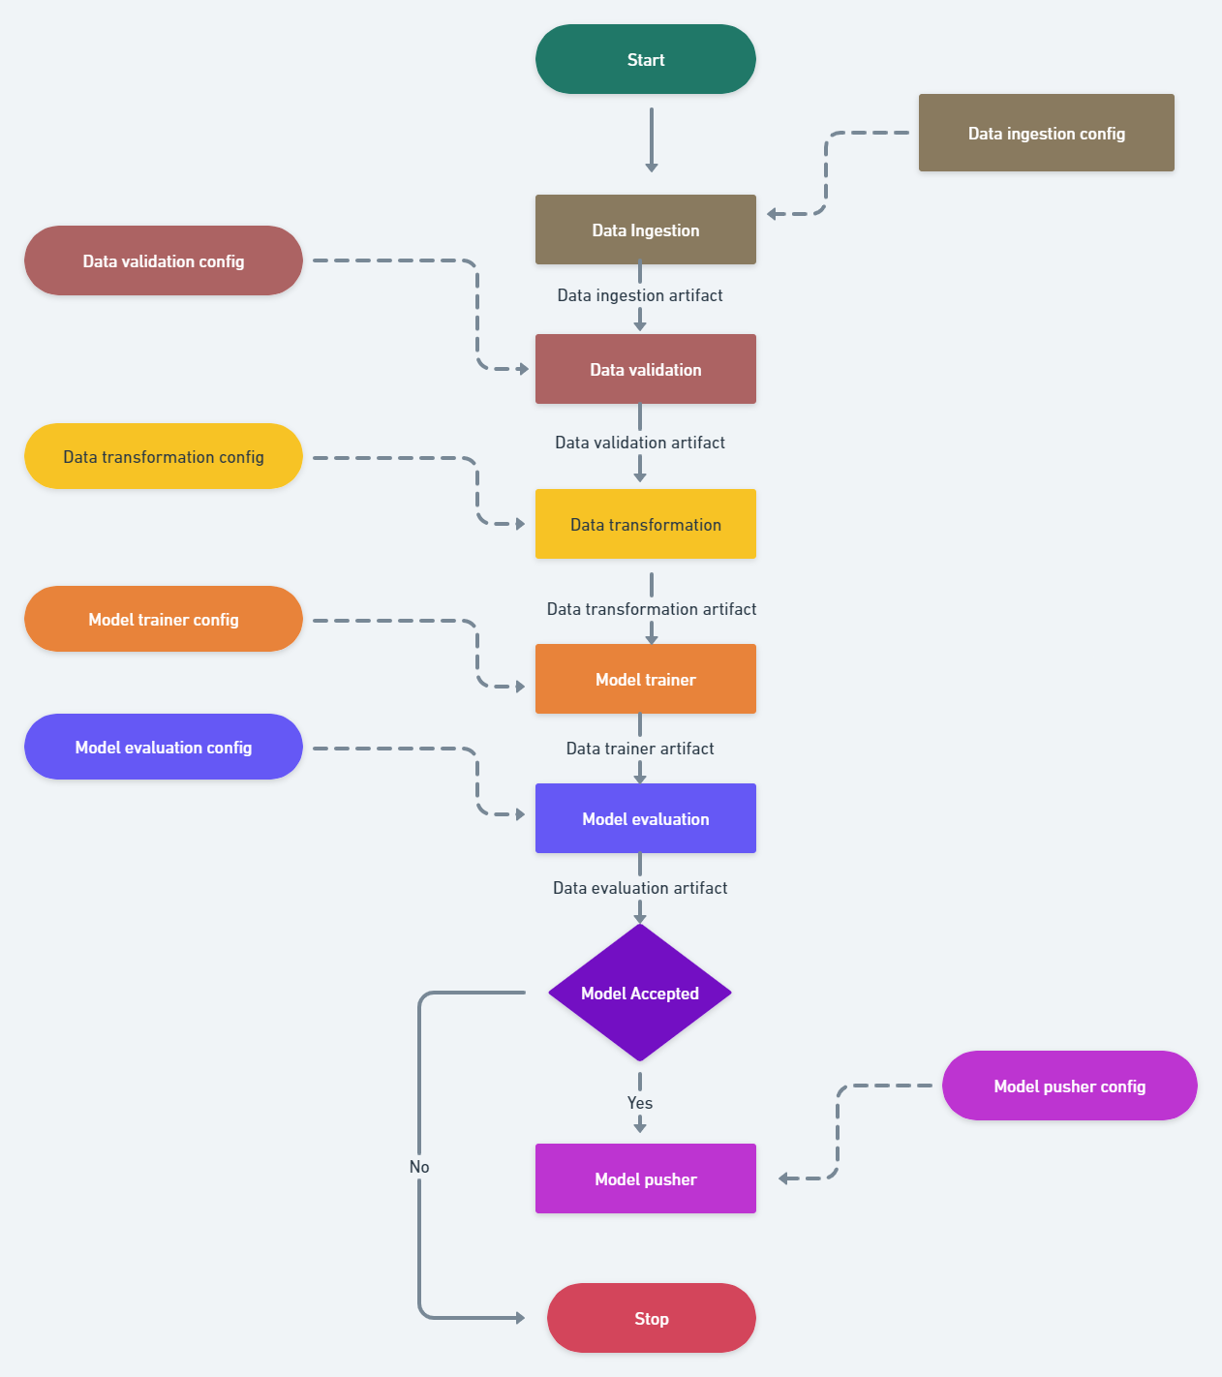
Modular MLOps Pipeline Overview
End-to-End Automation
The Intelligent Spam-Ham Classification System utilizes a modular, end-to-end MLOps pipeline, automating the entire machine learning lifecycle from data ingestion to deployment. This ensures efficiency and reduces manual intervention.
High Reliability and Scalability
Designed for high reliability and scalability, the pipeline incorporates robust components and cloud-native architecture (AWS) to handle increasing data volumes and user requests without degradation.

Slide 7
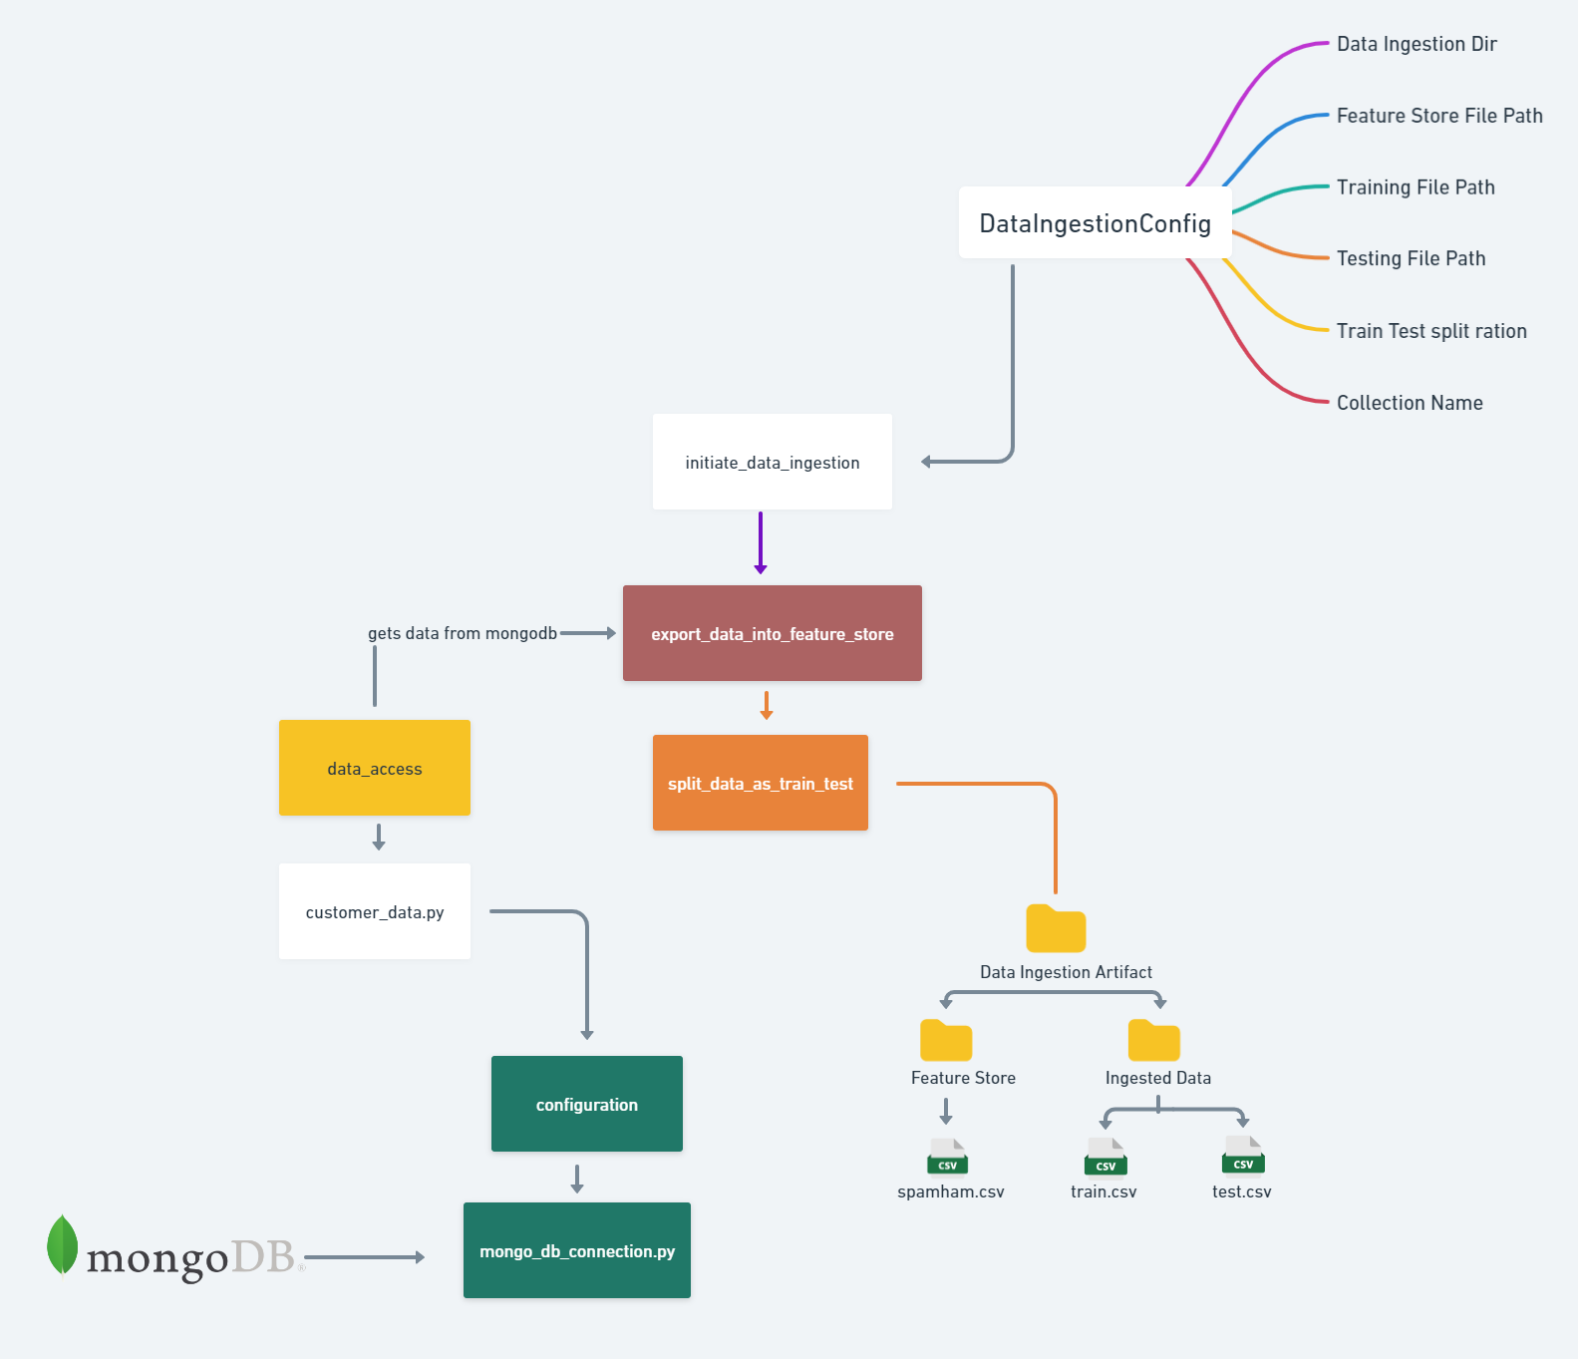
Data Ingestion and Validation
Secure Data Ingestion
The pipeline securely fetches raw text data from MongoDB Atlas using `mongo_db_connection.py`. This ensures a reliable and consistent data source for the ML environment.
Data Splitting and Feature Store
Ingested data is processed according to `DataIngestionConfig`, exported into a "Feature Store," and then split into `train.csv` and `test.csv` for subsequent phases.
Rigorous Schema Validation
The Data Validation component performs rigorous checks on incoming data, verifying the number of columns and data types against a predefined schema to guarantee model reliability.

Slide 8
Model Training and Hyperparameter Optimization
Algorithm Evaluation
01
The Model Trainer component evaluates multiple supervised learning algorithms, including Multinomial Naive Bayes, Gaussian Naive Bayes, and Support Vector Classifier (SVC), to identify the most accurate classification logic.
Automated Hyperparameter Tuning
02
GridSearchCV is employed to automate hyperparameter tuning, ensuring that the optimal configuration for each algorithm is discovered, maximizing model performance.
Performance Threshold Check
03
The best model's score is rigorously compared against a predefined "base model score." Only models that demonstrate superior performance are saved as `trained_model.pkl`.

Slide 9
Deployment and Continuous Integration/Continuous Delivery
01
Model Artifact Pushing
The Model Pusher component uploads the validated model artifact to the designated AWS S3 bucket and registers it in the AWS ECR (Elastic Container Registry), making it accessible for real-time predictions.
02
Containerization for Consistency
The entire application environment is packaged using Docker. This containerization ensures consistency across local development, testing, and cloud deployment environments, eliminating compatibility issues.
03
Automated CI/CD with GitHub Actions
GitHub Actions workflows automate the deployment process, triggering new builds and deployments whenever changes are pushed to the repository, enabling continuous integration and continuous delivery.

Slide 10
Software Stack and Development Tools
Programming Language: Python 3.7+
Python 3.7+ is the primary programming language used for developing the data pipelines, machine learning operations, and overall system logic of the Intelligent Spam-Ham Classification System.
Machine Learning Libraries: Scikit-Learn
Scikit-Learn is a fundamental library for model development, implementing algorithms such as Multinomial Naive Bayes, Gaussian Naive Bayes, and Support Vector Classifier (SVC) for text classification.
API Frameworks: FastAPI/Flask
FastAPI or Flask is employed to create the prediction API, enabling external applications to send text for real-time classification and receive results from the deployed machine learning model.

Slide 11
Software Stack and Development Tools
Development Environment: Visual Studio Code
Visual Studio Code serves as the main code editor and integrated development environment (IDE) for all development activities related to the project.
Containerization: Docker
Docker is used as the containerization engine to standardize the application's environment, ensuring consistency across local development, testing, and cloud deployment platforms.
Version Control & CI/CD: Git & GitHub Actions
Git is utilized for version control, while GitHub Actions automates the continuous integration and continuous deployment (CI/CD) pipelines, streamlining the delivery of new features and model updates.

Slide 12
Activity Diagram: MLOps Pipeline Workflow
Initiation and Data Handling
01
The workflow begins with an ingestion signal, leading to "Data Ingestion & Validation" from MongoDB Atlas, schema validation, and storage in the feature store.
Data Transformation and Model Training
02
Following validation, "Data Transformation" converts text into numerical vectors using NLP. Subsequently, "Model Training & Evaluation" assesses algorithms (MultinomialNB, GaussianNB, SVC) against a base model.
Decision and Deployment
03
A "Decision Node" determines if the new model is accepted. If yes, it's pushed to AWS S3 and ECR via Docker; otherwise, the existing model is retained. The process concludes with finalized deployment.

Slide 13
Sequence Diagram: Real-time Prediction Flow
01
User Request and Model Retrieval
The sequence starts with a "User" sending a raw message via the API endpoint. The "Prediction API" then requests the best-performing model from AWS S3 cloud storage.
02
Text Preprocessing and Probability Calculation
Once loaded into memory, the model preprocesses the input text. The system then calculates the probability distribution for the message, determining its likelihood of being Spam or Ham.
03
Classification Result Delivery
Finally, the system identifies the "Class label" (Spam or Ham) and returns this classification result back to the user, completing the real-time prediction request.

Slide 14
Key Achievements and Future Directions
Successful Implementation of MLOps Pipeline
The project successfully developed and implemented an end-to-end, automated MLOps pipeline for spam-ham classification, demonstrating high predictive accuracy and adaptability through NLP techniques and supervised machine learning algorithms.
Robust Model Governance and Deployment
Key achievements include automated data processing, schema validation, and a model evaluation component that acts as a gatekeeper, ensuring only superior models reach production. The system is deployed using Docker, AWS S3, and AWS ECR for scalability and consistent behavior.

Slide 15
Key Achievements and Future Directions
Advanced Deep Learning Integration
Future enhancements include upgrading the system architecture to incorporate deep learning models like LSTMs or Transformer-based architectures (e.g., BERT) to capture more complex contextual nuances in text data.
Real-Time Platform Integration
Future work involves creating direct integrations with messaging platforms (SMS, email) using APIs like Twilio or Gmail to enable real-time filtering and quarantining of messages, enhancing immediate digital security.

Slide 16
Thankyou

